Slide 1
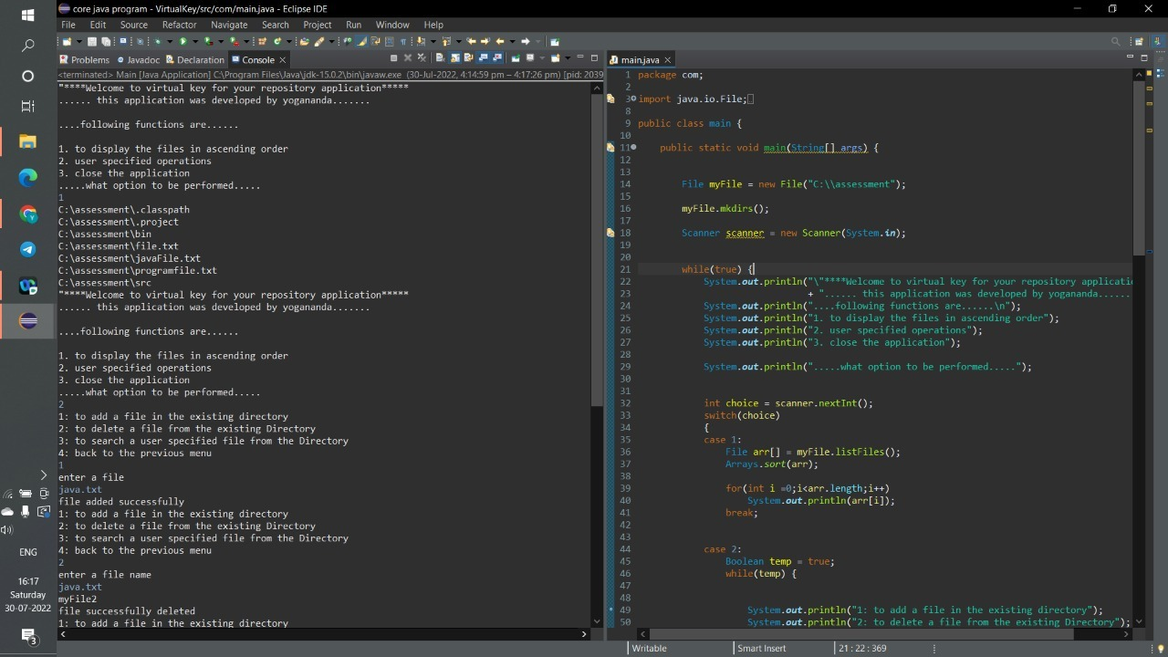
Virtual key for your repositories output screenshots

Slide 2
